Slide 1


Slide 2
Marcel Projections
Past 3 Seasons of Data to predict upcoming season
5/4/3 weighting
Age Factor, centered around age 29 season
This round with just AVG/OBP/SLG/BB Rate/ K Rate
General rule of at least 400 PAs
Run Quick Linear Regression on Proj Stat vs Actual Stat
2018-2024 Projections

Slide 3
Linear Regressions
Run Quick Linear Regression on Proj Stat vs Actual Stat
Positive Slope between Proj Stat and Actual Stat
Good p-values in lin regression
Consistent residuals for 2018, 2019, 2023

Slide 4
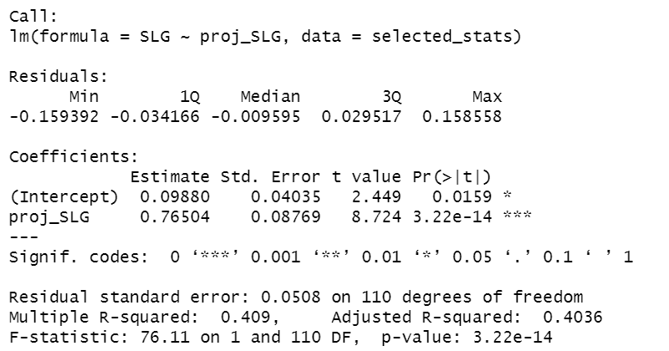
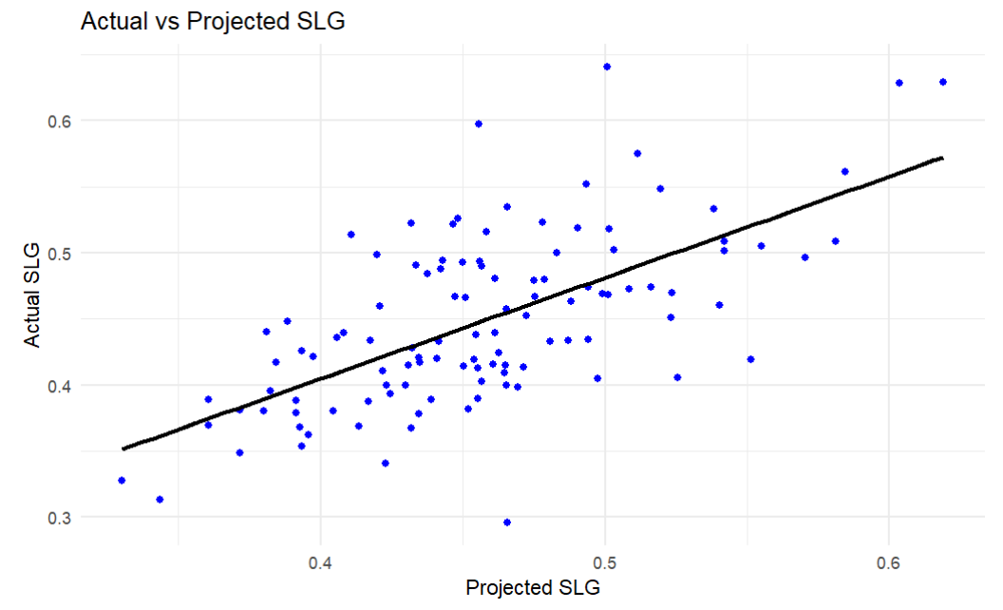
Marcel Projection 2018
-8.7 % Avg Error in overall projections
Best model was SLG

Slide 5
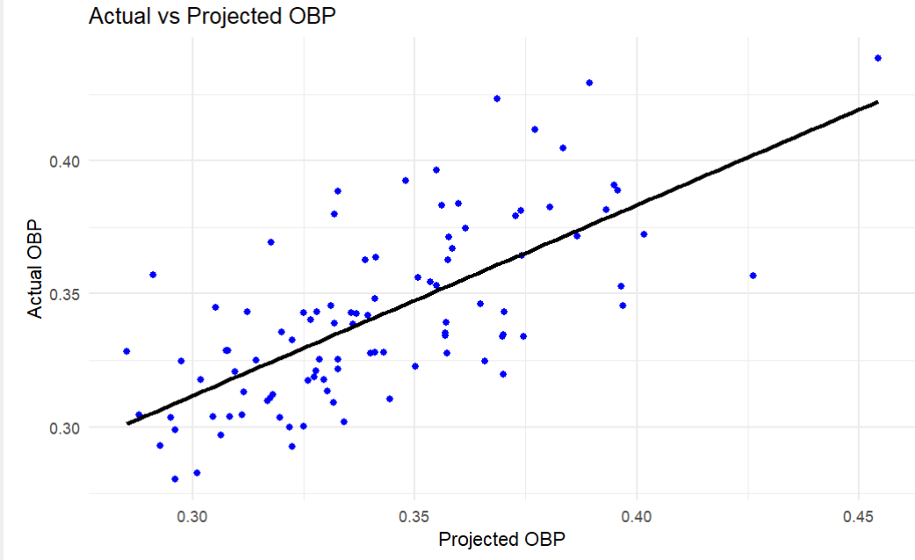
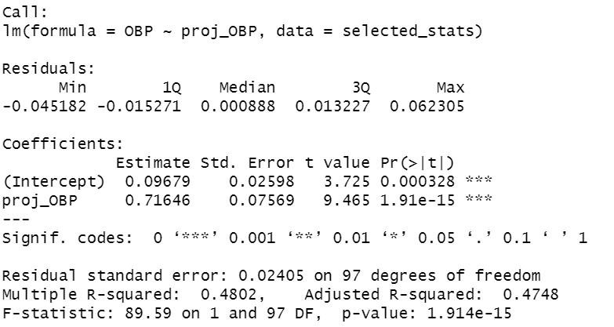
Marcel Projection 2019 (Best Result)
-0.4 % Avg Error in overall projections
Best model was OBP

Slide 6
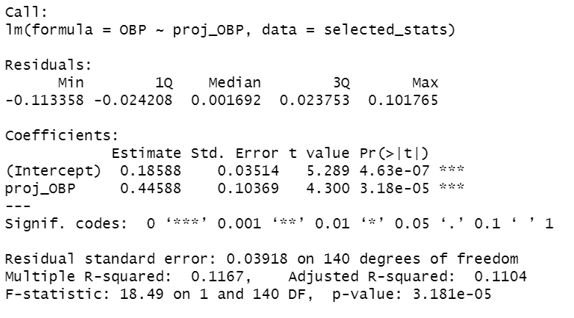
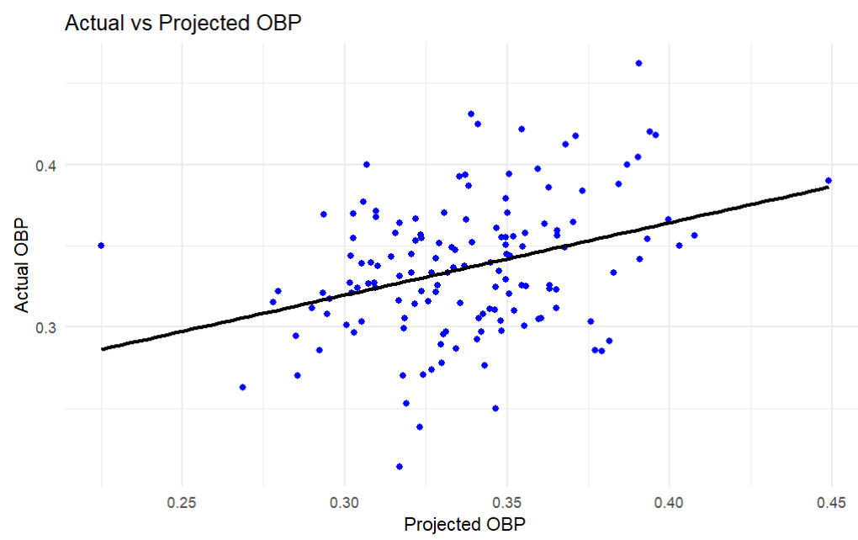
Marcel Projection 2020 (The Monkey Wrench)
-11.4 % Avg Error in overall projections
COVID year, smaller sample, threshold 150 PAs
Positive Slope between Proj Stat and Actual Stat
Ok p-values in lin regression, some bigger residuals and outliers

Slide 7
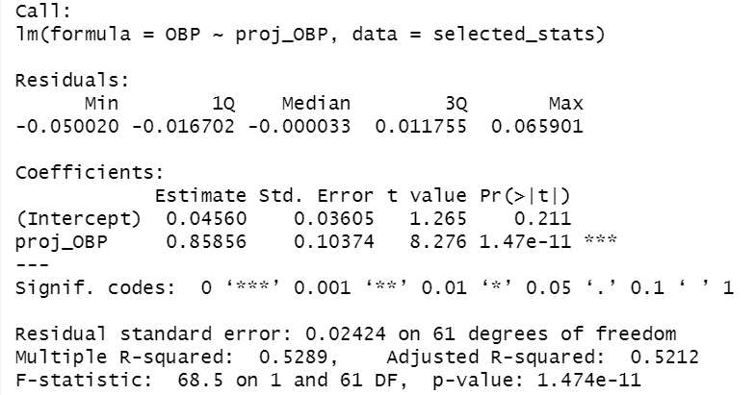
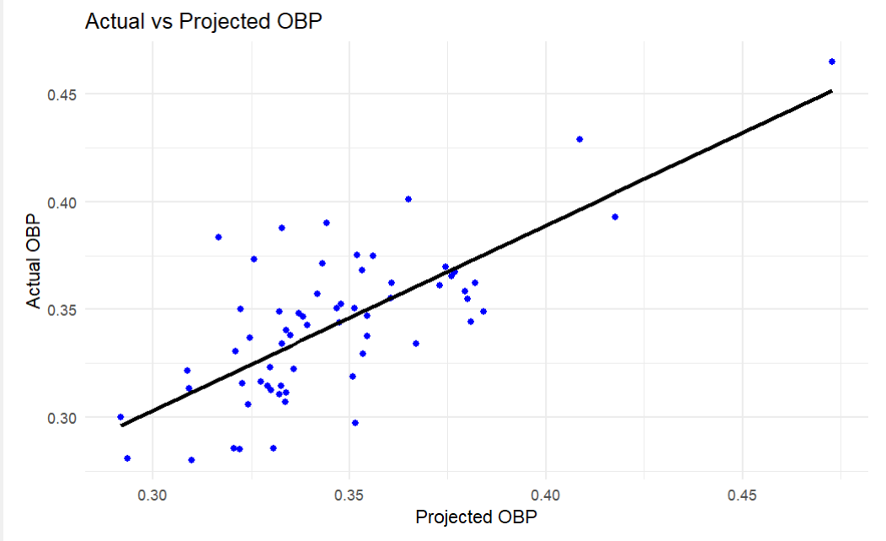
Marcel Projection 2021
-11.7 % Avg Error in overall projections
Affected by COVID Season, only 63 players meeting the three previous year’s PA threshold

Slide 8
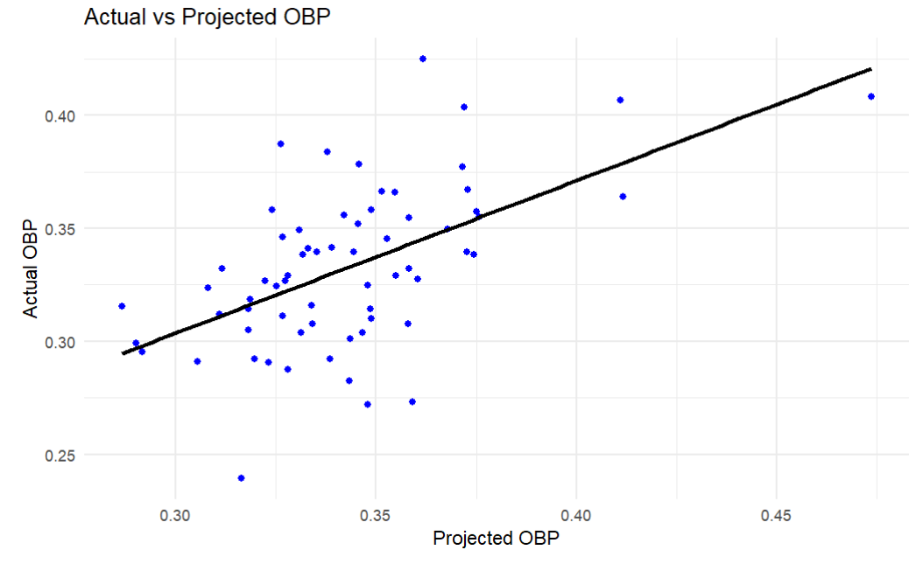
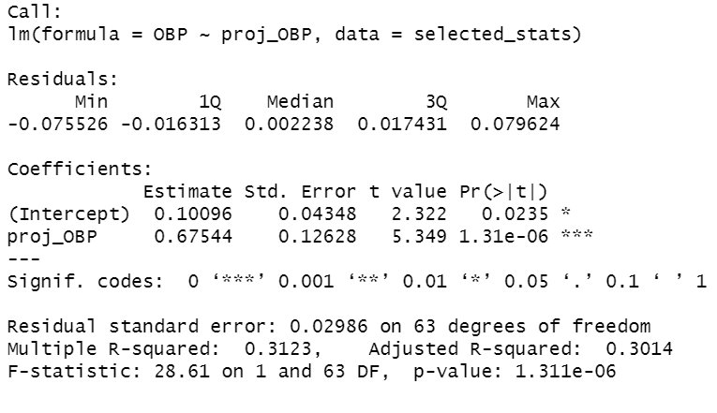
Marcel Projection 2022
-32.1 % Avg Error in overall projections
Affected by COVID Season, only 65 players meeting the three previous year’s PA threshold
Some really bad outliers, Jonathan Schoop, Yoan Moncada, Jeimer Candelario

Slide 9
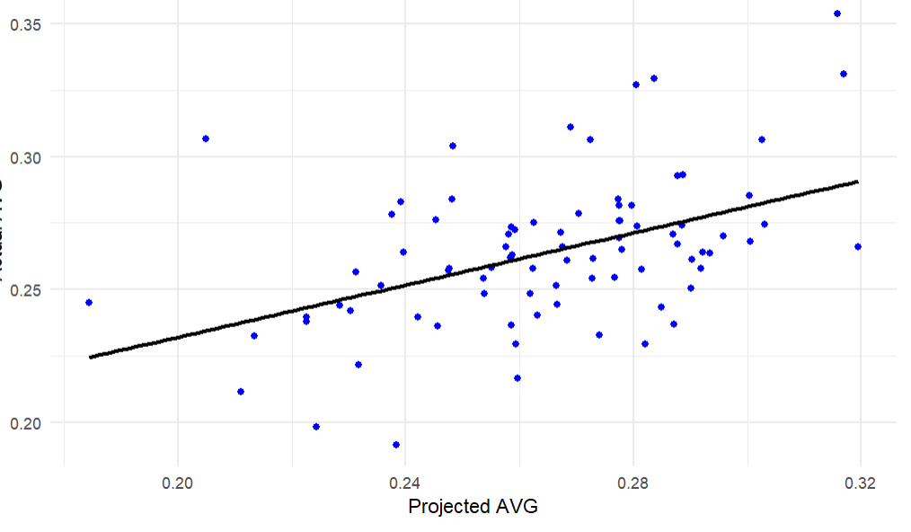
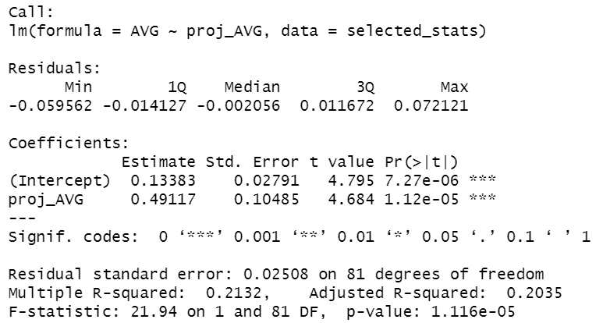
Marcel Projection 2023
-4.5 % Avg Error in overall projections
Much better with full sample size

Slide 10
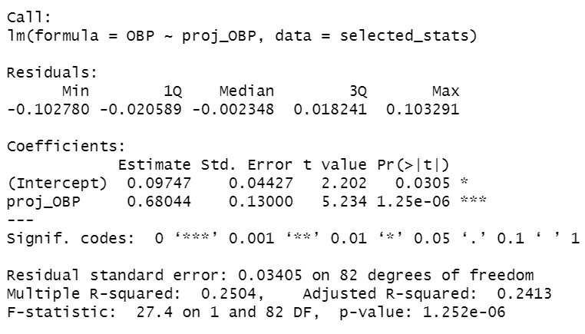
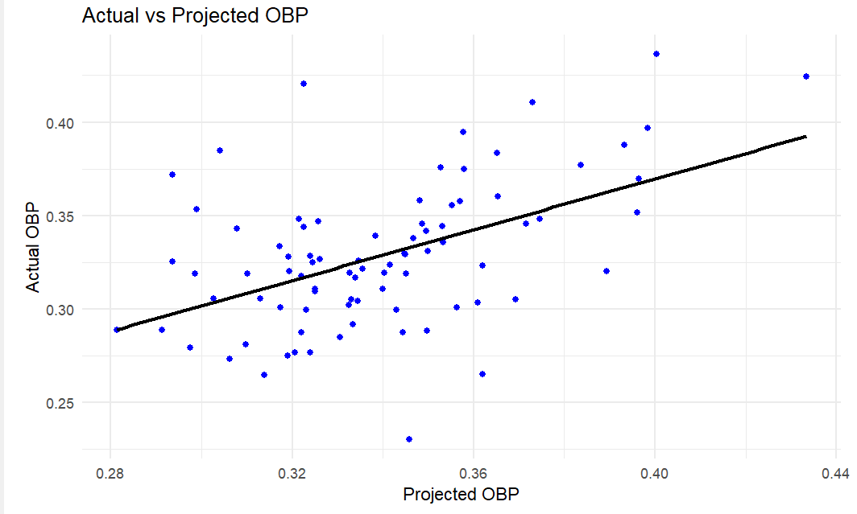
Marcel Projection 2024
-29 % Avg Error in overall projections
Still early in the year, only 200 PAs min

Slide 11
Marcel Projection Final Notes
Really solid projections with three full seasons
Always positive correlation between projected rate and actual rate
Options to expand
Pitching
4th Season
Add in minor league seasons and include minor league factor for those seasons
Adjust age factor so projections get a bit lower than actual

